Slide 1
Water Valve Defect Inspection
游凱任 Kai-Jen Yu
Professor: 傅楸善 Chiou-Shann Fuh
Email: r10922170@ntu.edu.tw
Phone: 0913880410
Collaboration: 晟格科技 Chernger

Slide 2
Outline
Introduction
Environment
Demonstration
Process
Problems and Solutions
Conclusion
Reference

Slide 3
Introduction
Water valve cores have been used in our lives for a long time, and Maruwa (丸和) company manufactures many water valve cores everyday.
However, during the production process, there are some defect on valve cores.
Our goal is to inspect all defects with optical defect inspection.
Notes:
水閥芯已經在我們的生活中使用了很長時間，丸和（Maruwa）公司每天都生產大量的水閥芯。
然而，在生產過程中，水閥芯上會出現一些缺陷。
我們的目標是通過光學瑕疵檢測來檢查所有的缺陷。

Slide 4
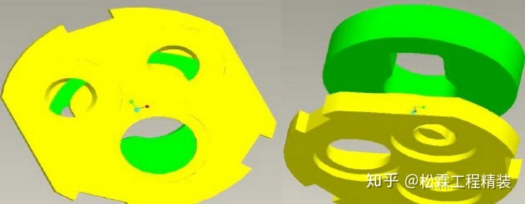
Introduction
Water valve core usually has three parts.
Select cold or hot water or stop water by turning the faucet.
There are chipping and crack and no lap defects on valve cores, these defects will interfere with the original capabilities.
Hence, we need to find out all the defects to guarantee the yield rate.
Notes:
水閥芯通常由三個部分組成。
通過轉動水龍頭來選擇冷水、熱水或停水。
水閥芯上可能存在剝落、裂紋和無鎖縫瑕疵，這些瑕疵會影響他的密封性，使不同水溫的水串流。
因此，我們需要找出所有的缺陷，以確保產品的良率。

Slide 5
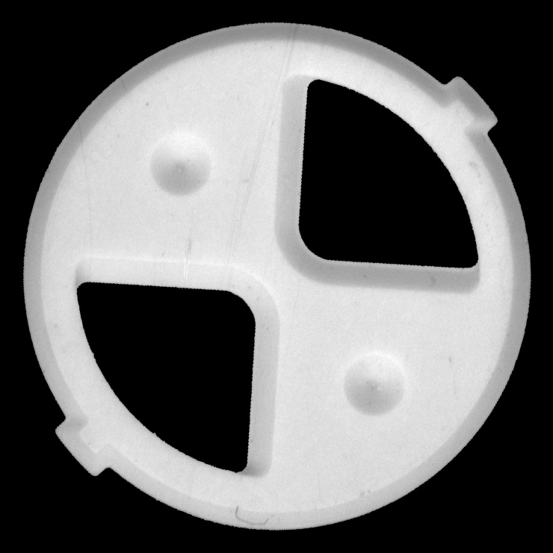
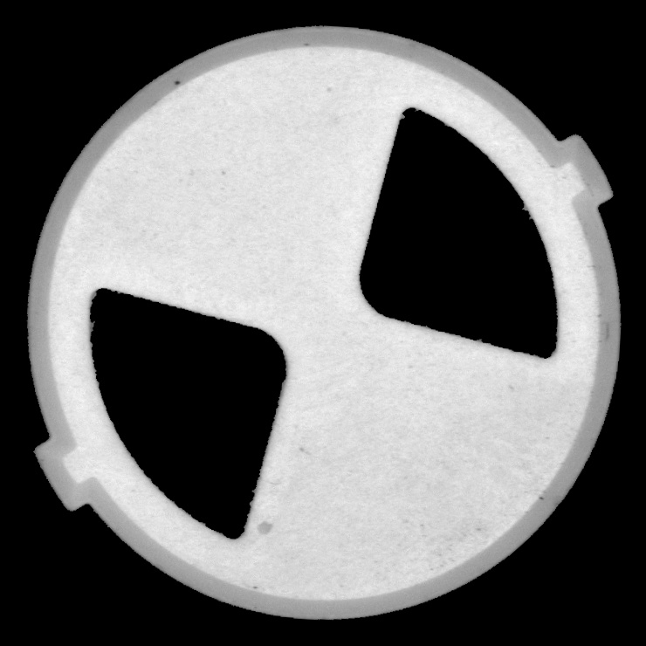
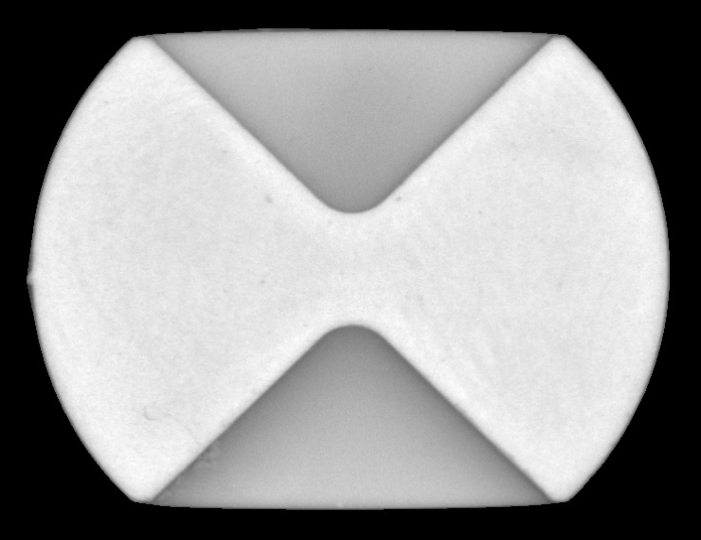
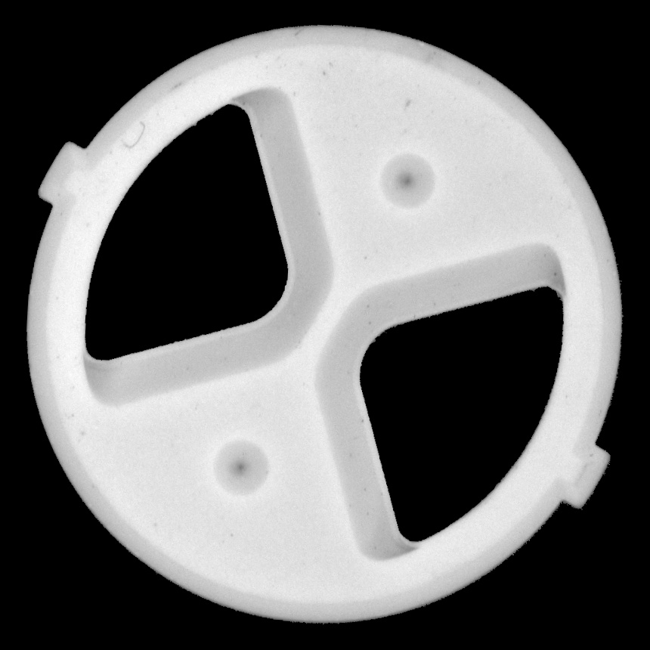
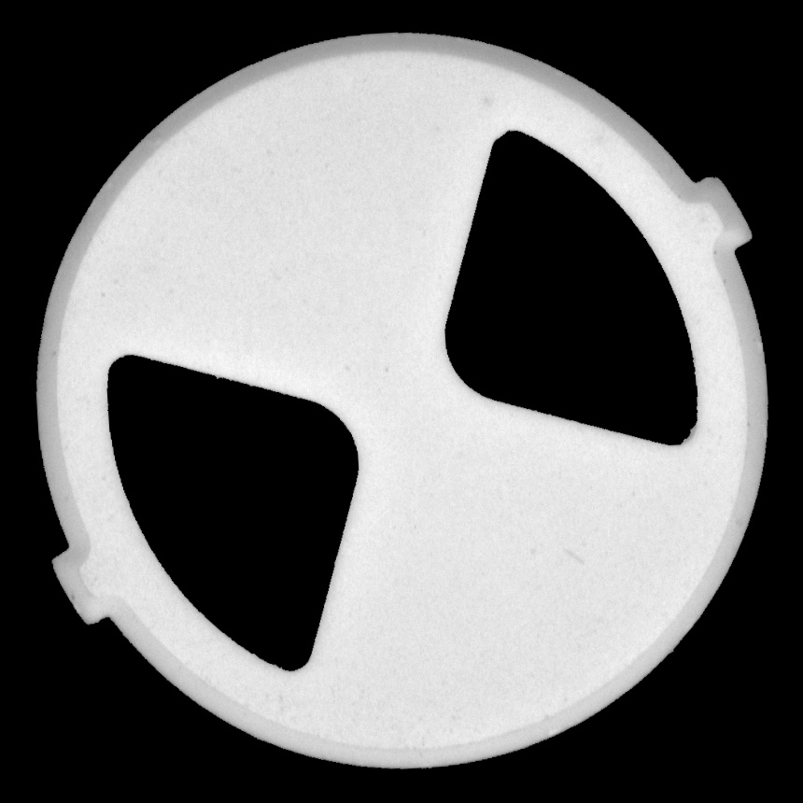
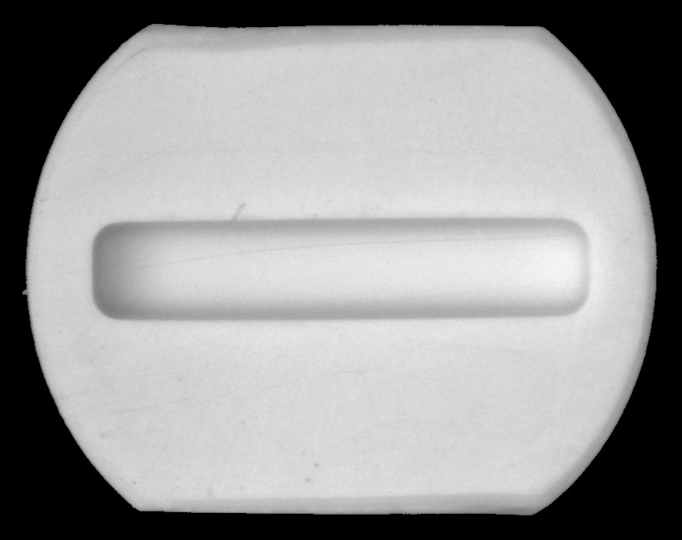
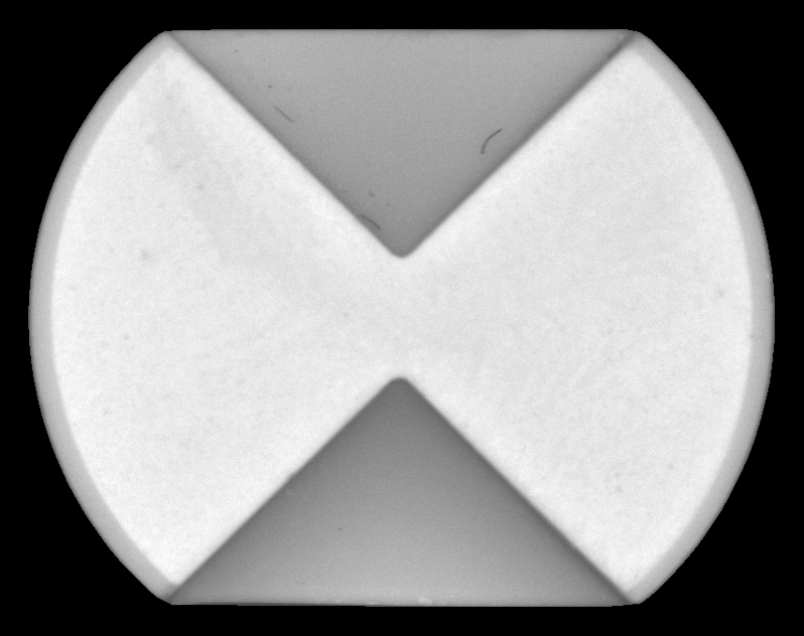
Introduction
140C back
740*570 pixels
140C front
140N back
140N front
740*740 pixels
KNT1 back
KNT1 front
KNT2 back
KNT2 front
860*860 pixels
860*680 pixels

Slide 6
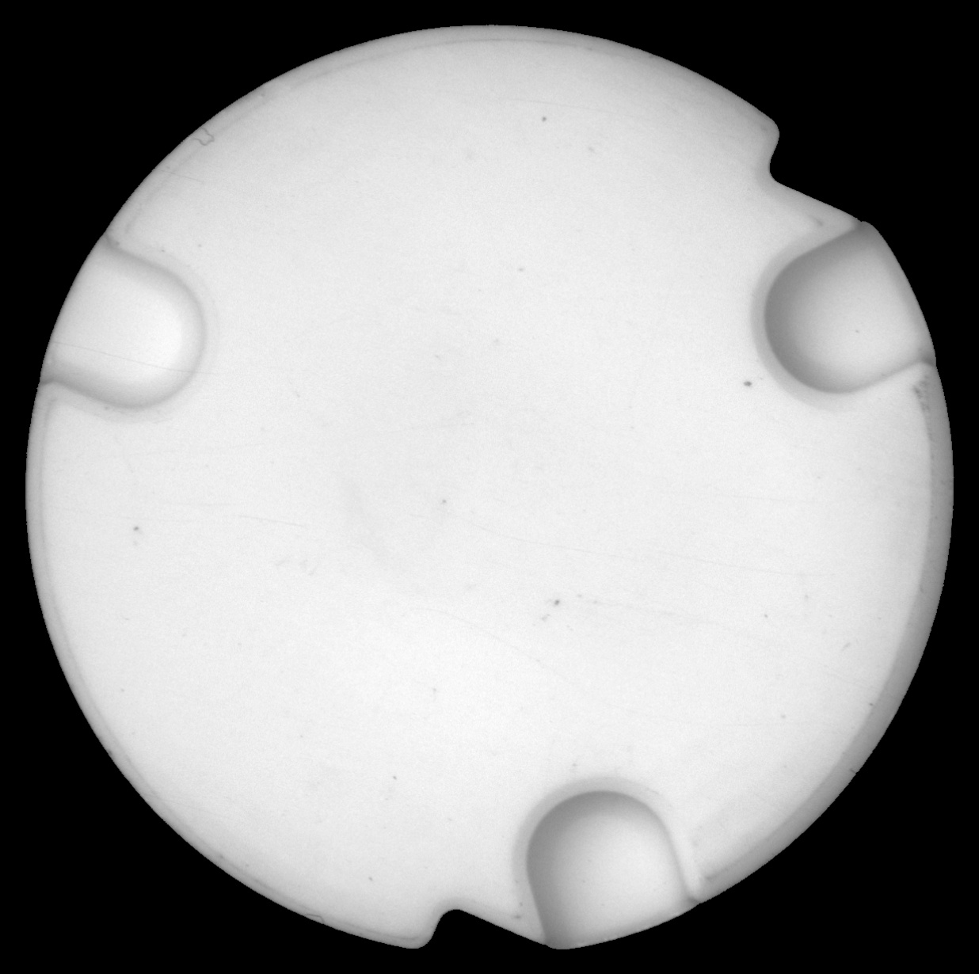
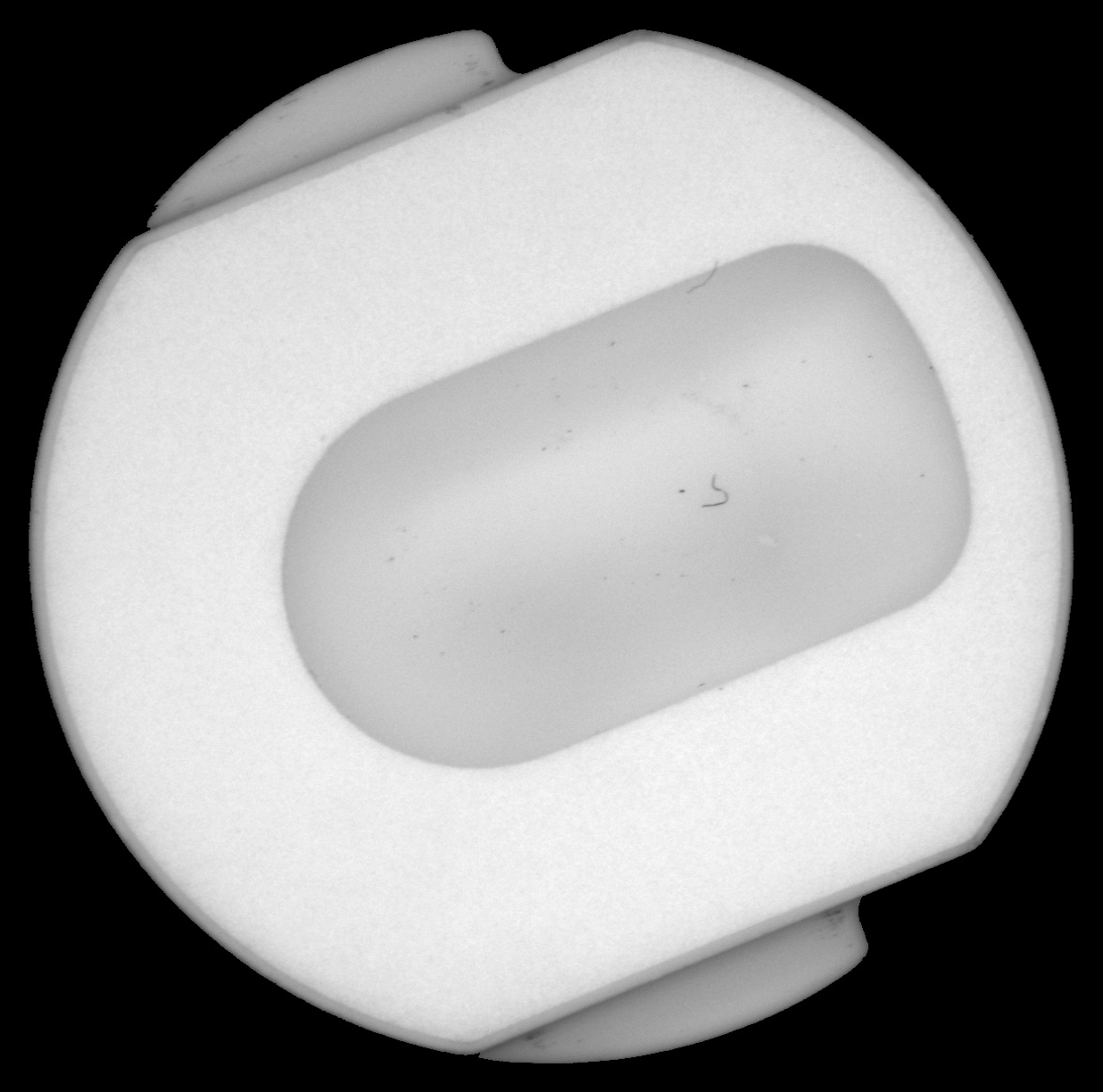
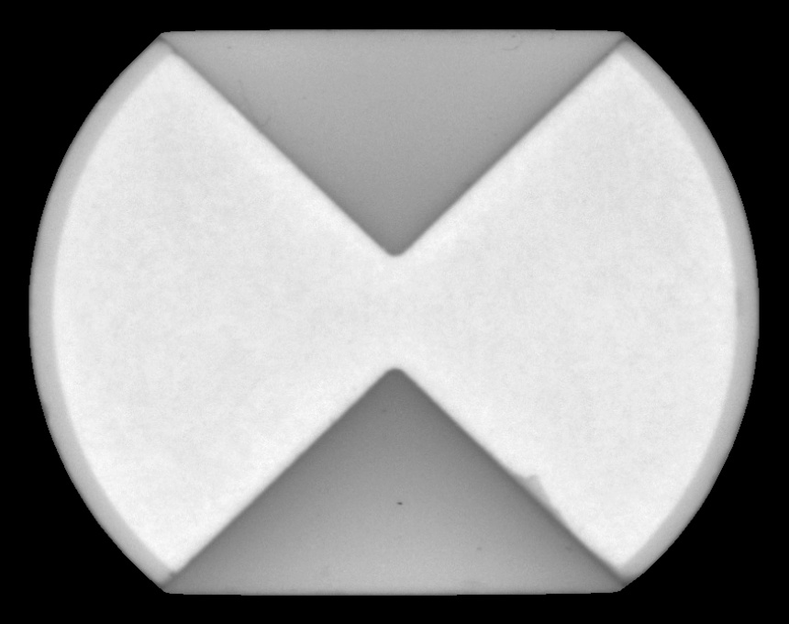
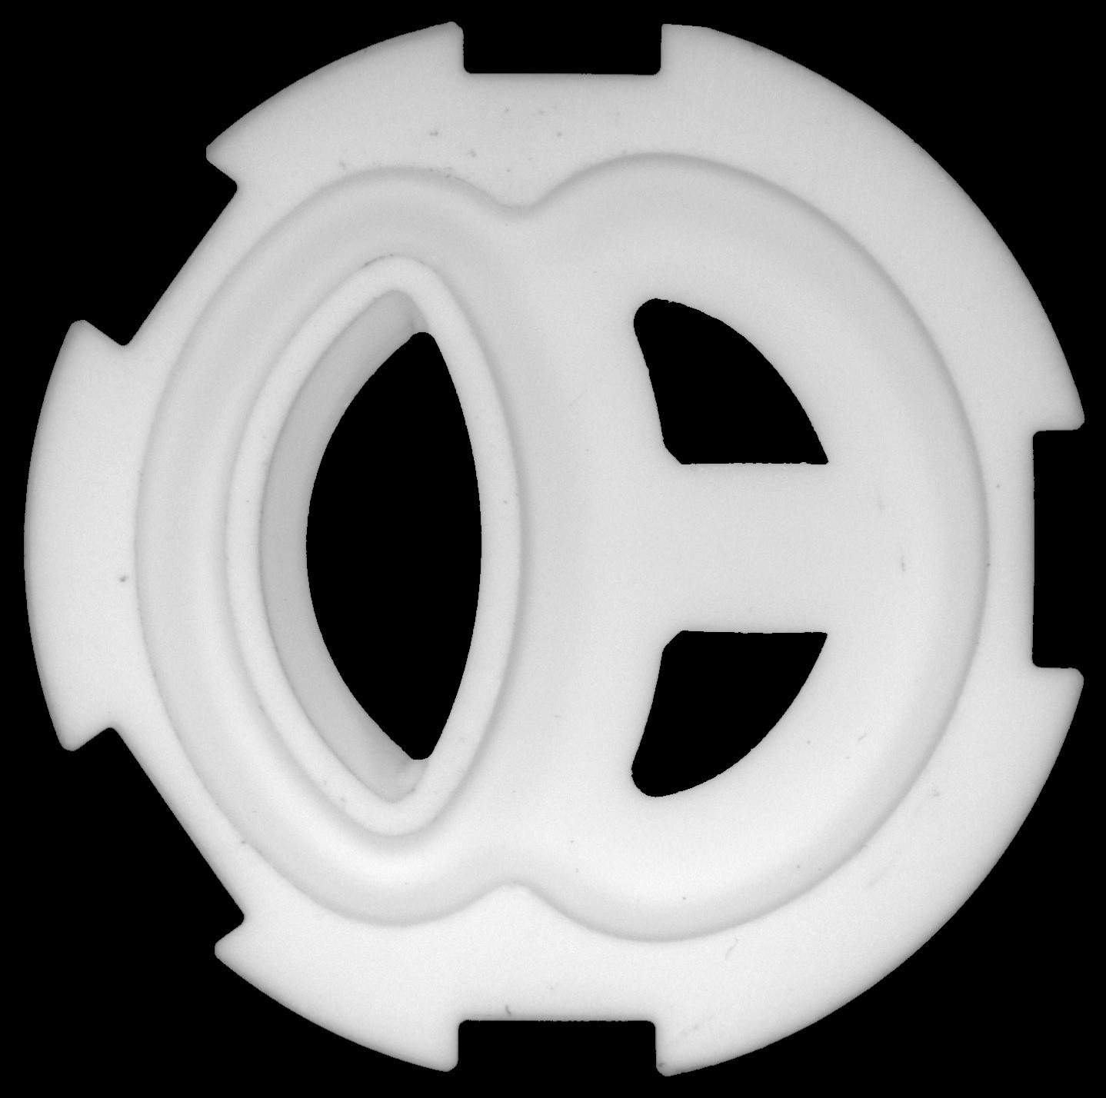
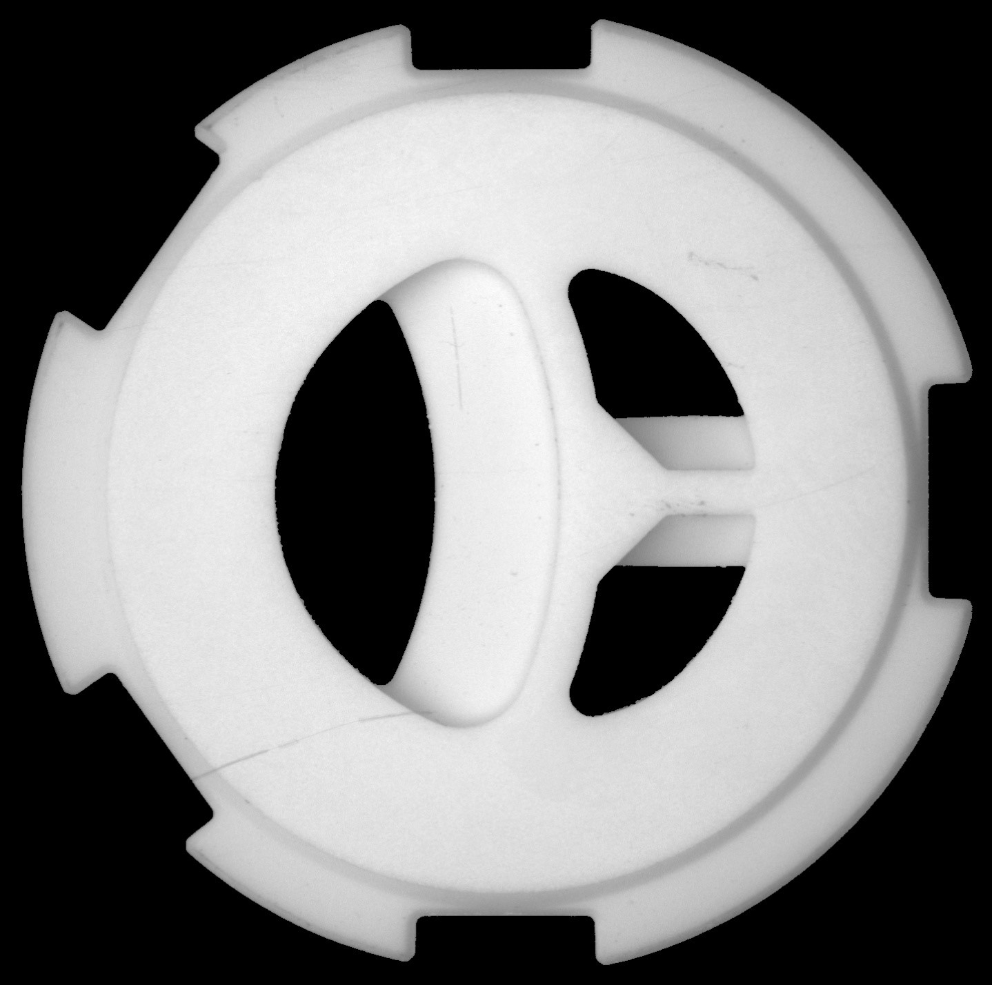
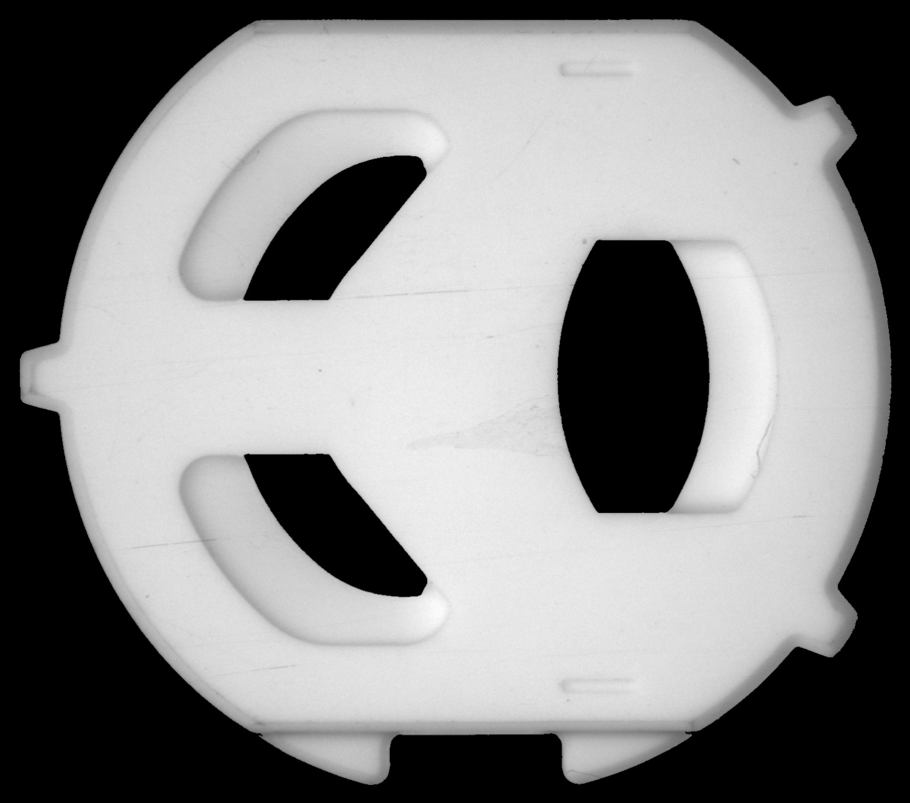
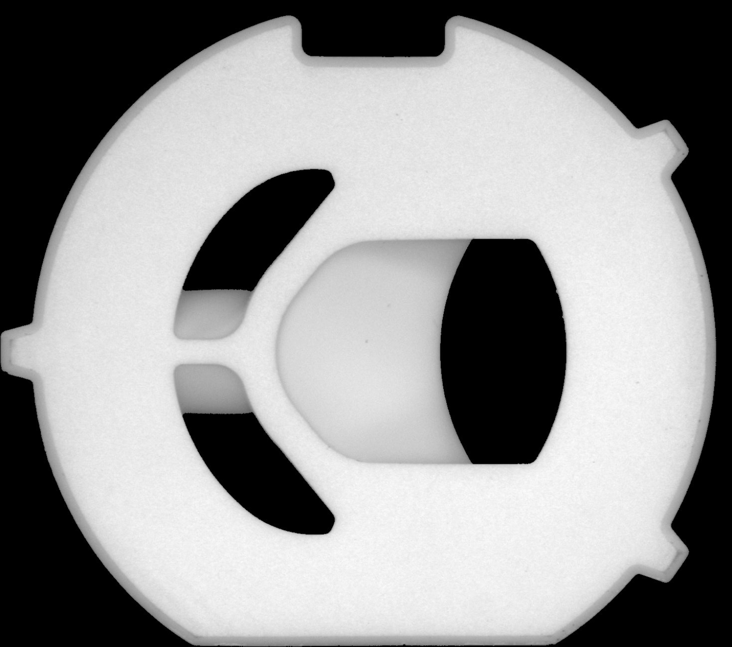
Introduction
YNT2 back
YNT2 front
M38N back
M38N front
860*680 pixels
1,236*1,230 pixels
M89F back
M89F front
D68F back
D68F front
1,468*1,296 pixels
1,438*1,428 pixels

Slide 7
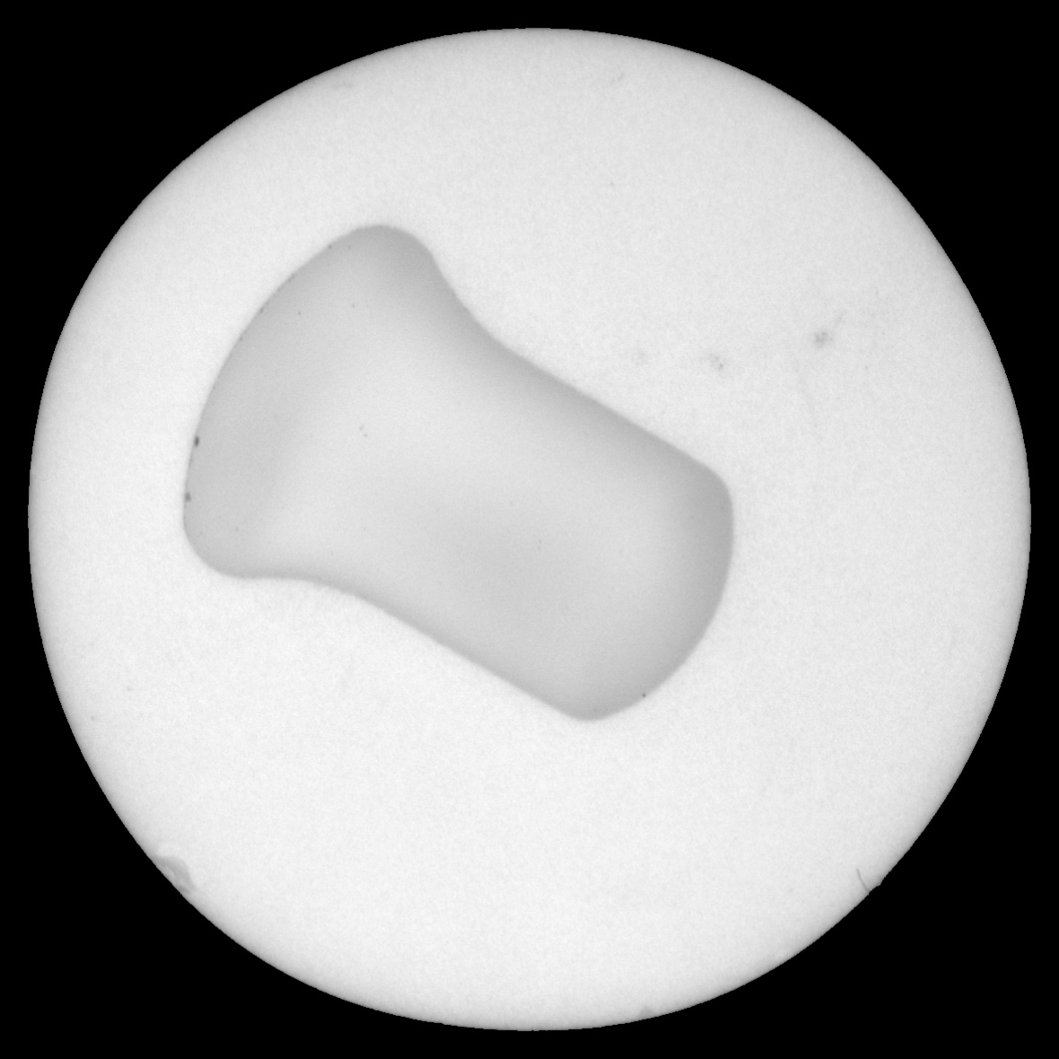
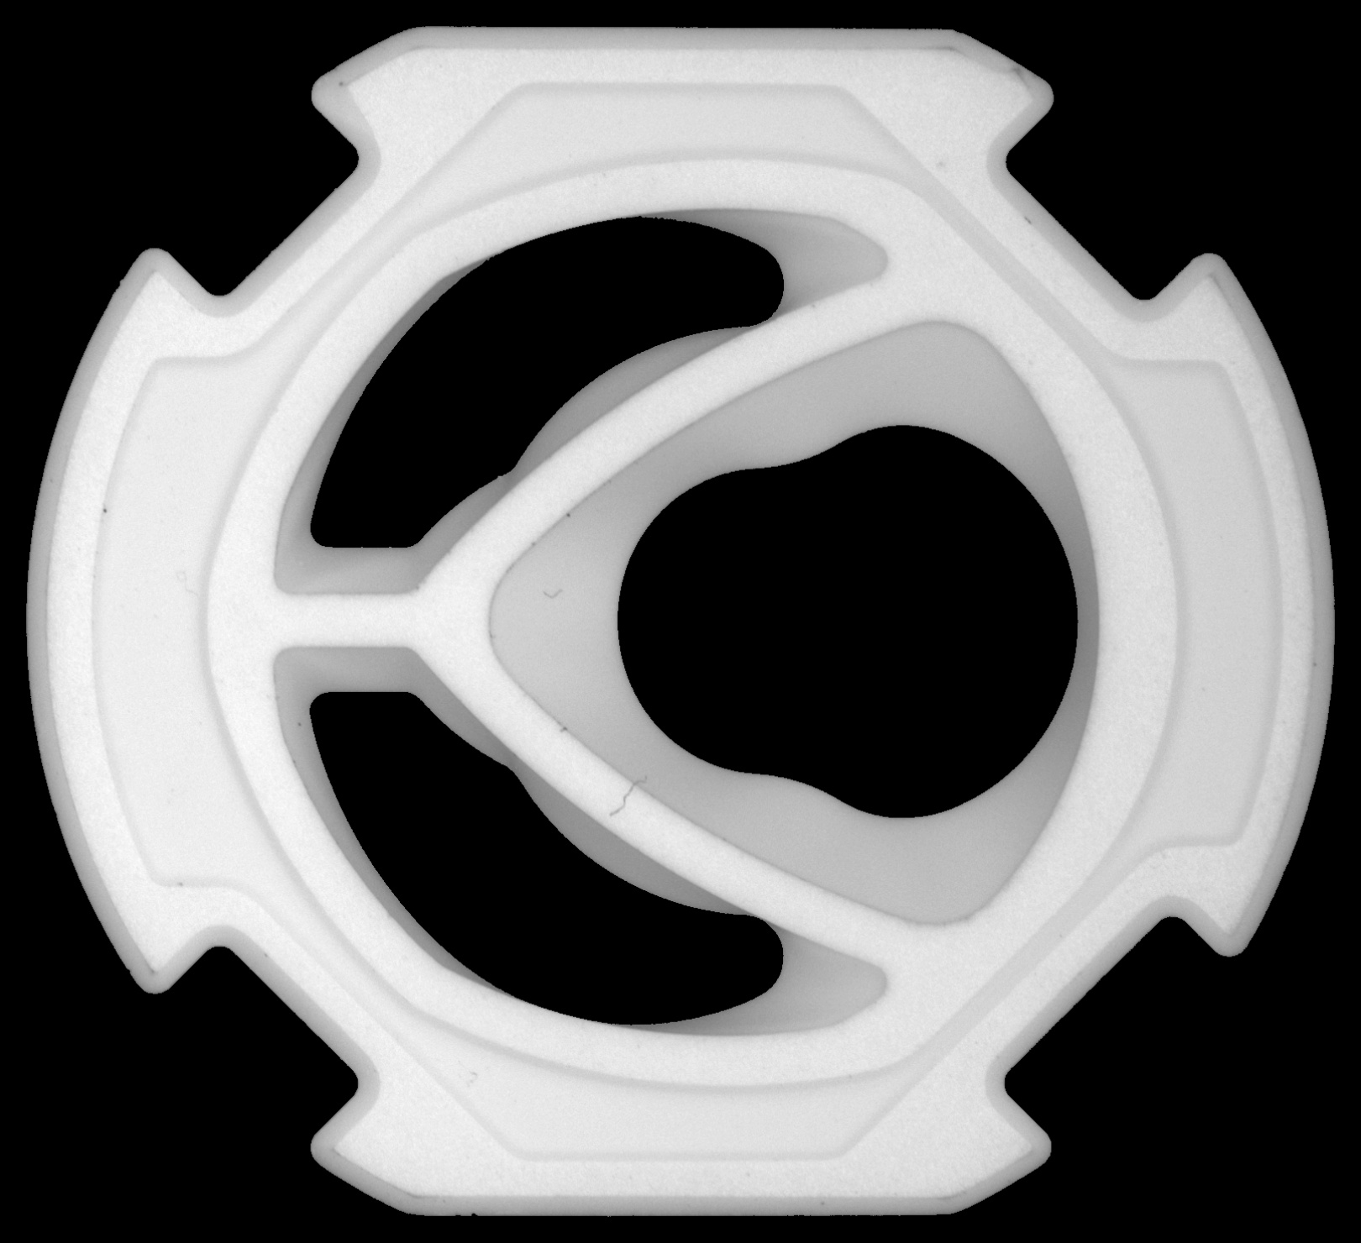
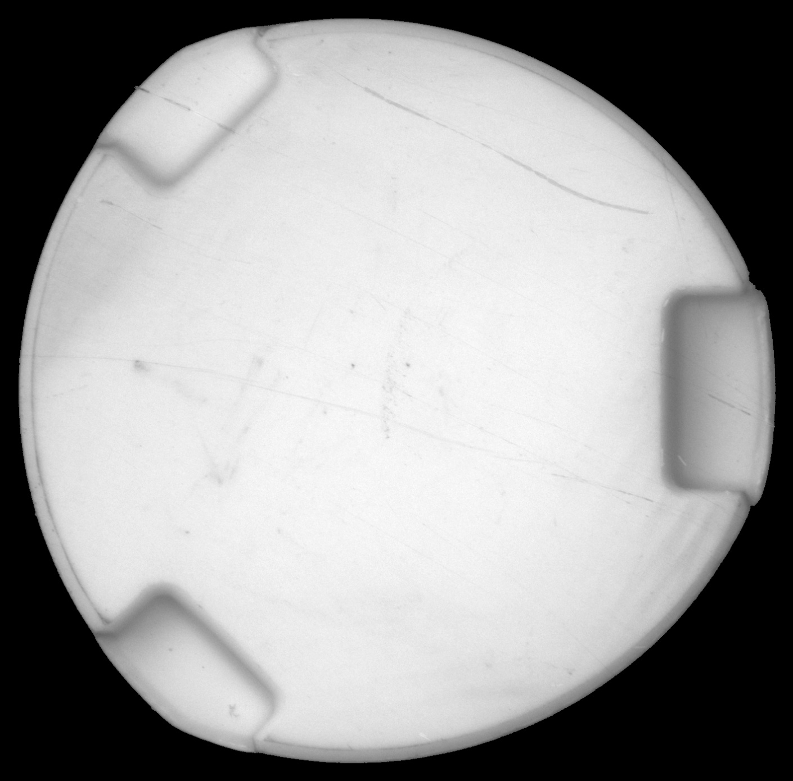
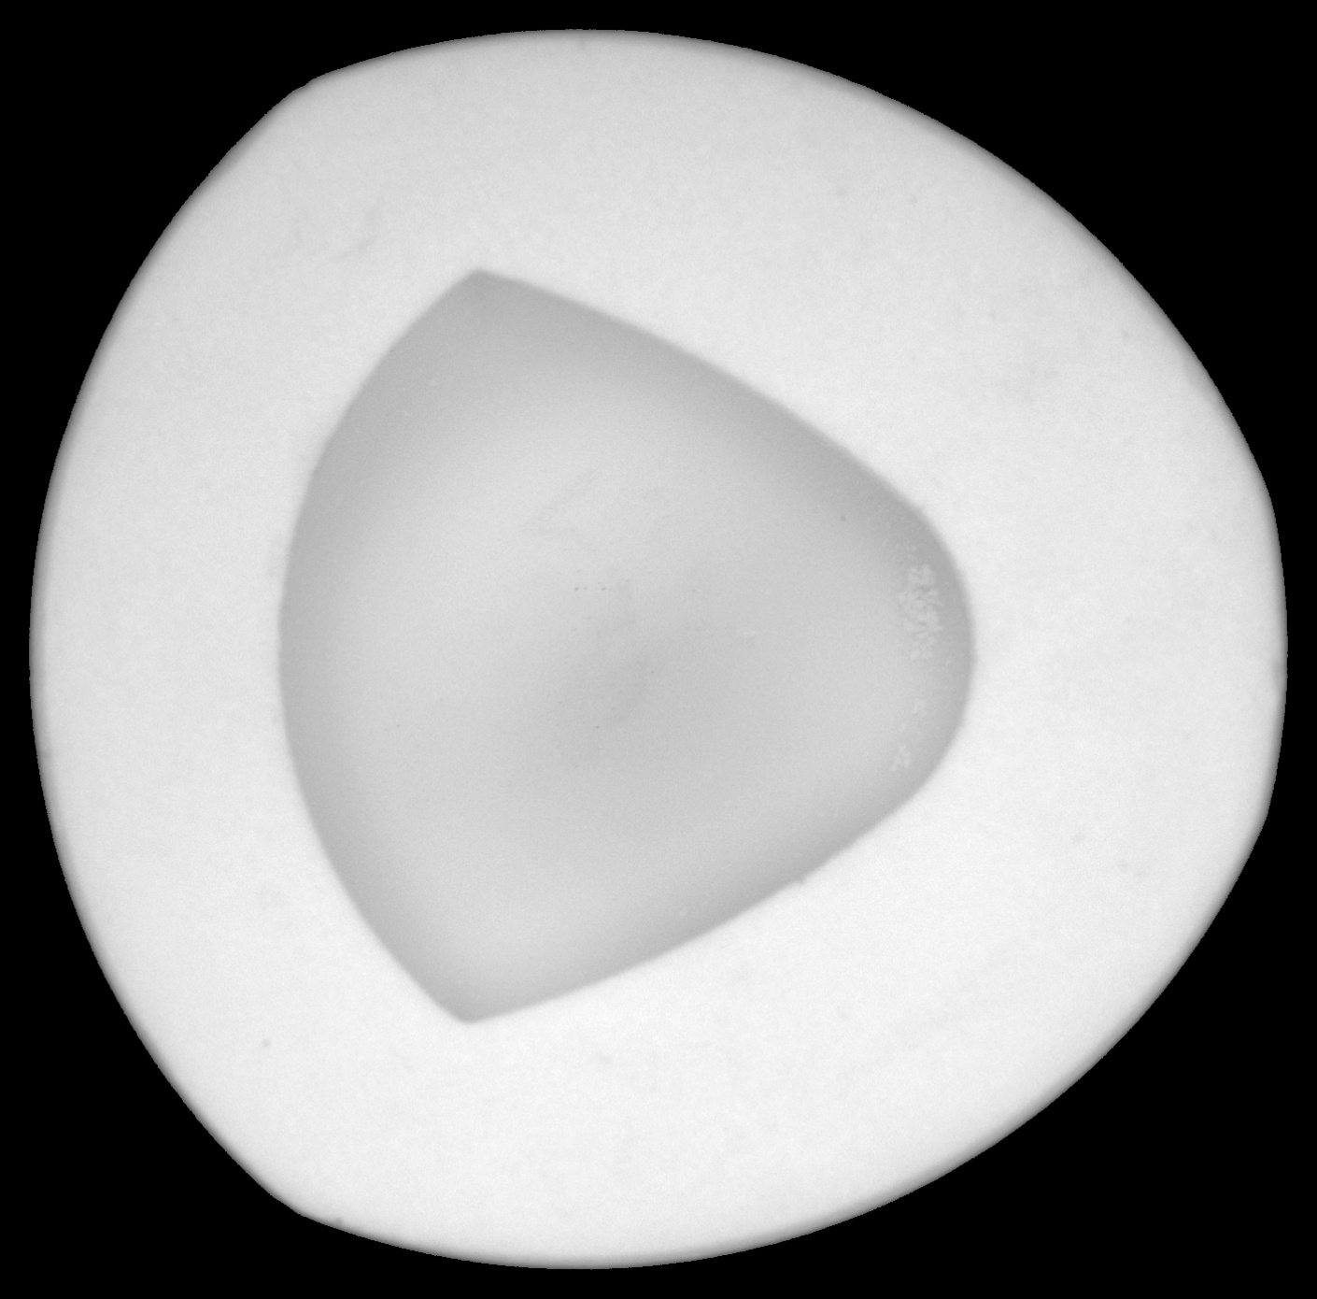
Introduction
D69M back
D69M front
P35F back
P35F front
1,190*1,183 pixels
1,620*1,480 pixels
P35M back
1,410*1,390 pixels
P35M front

Slide 8
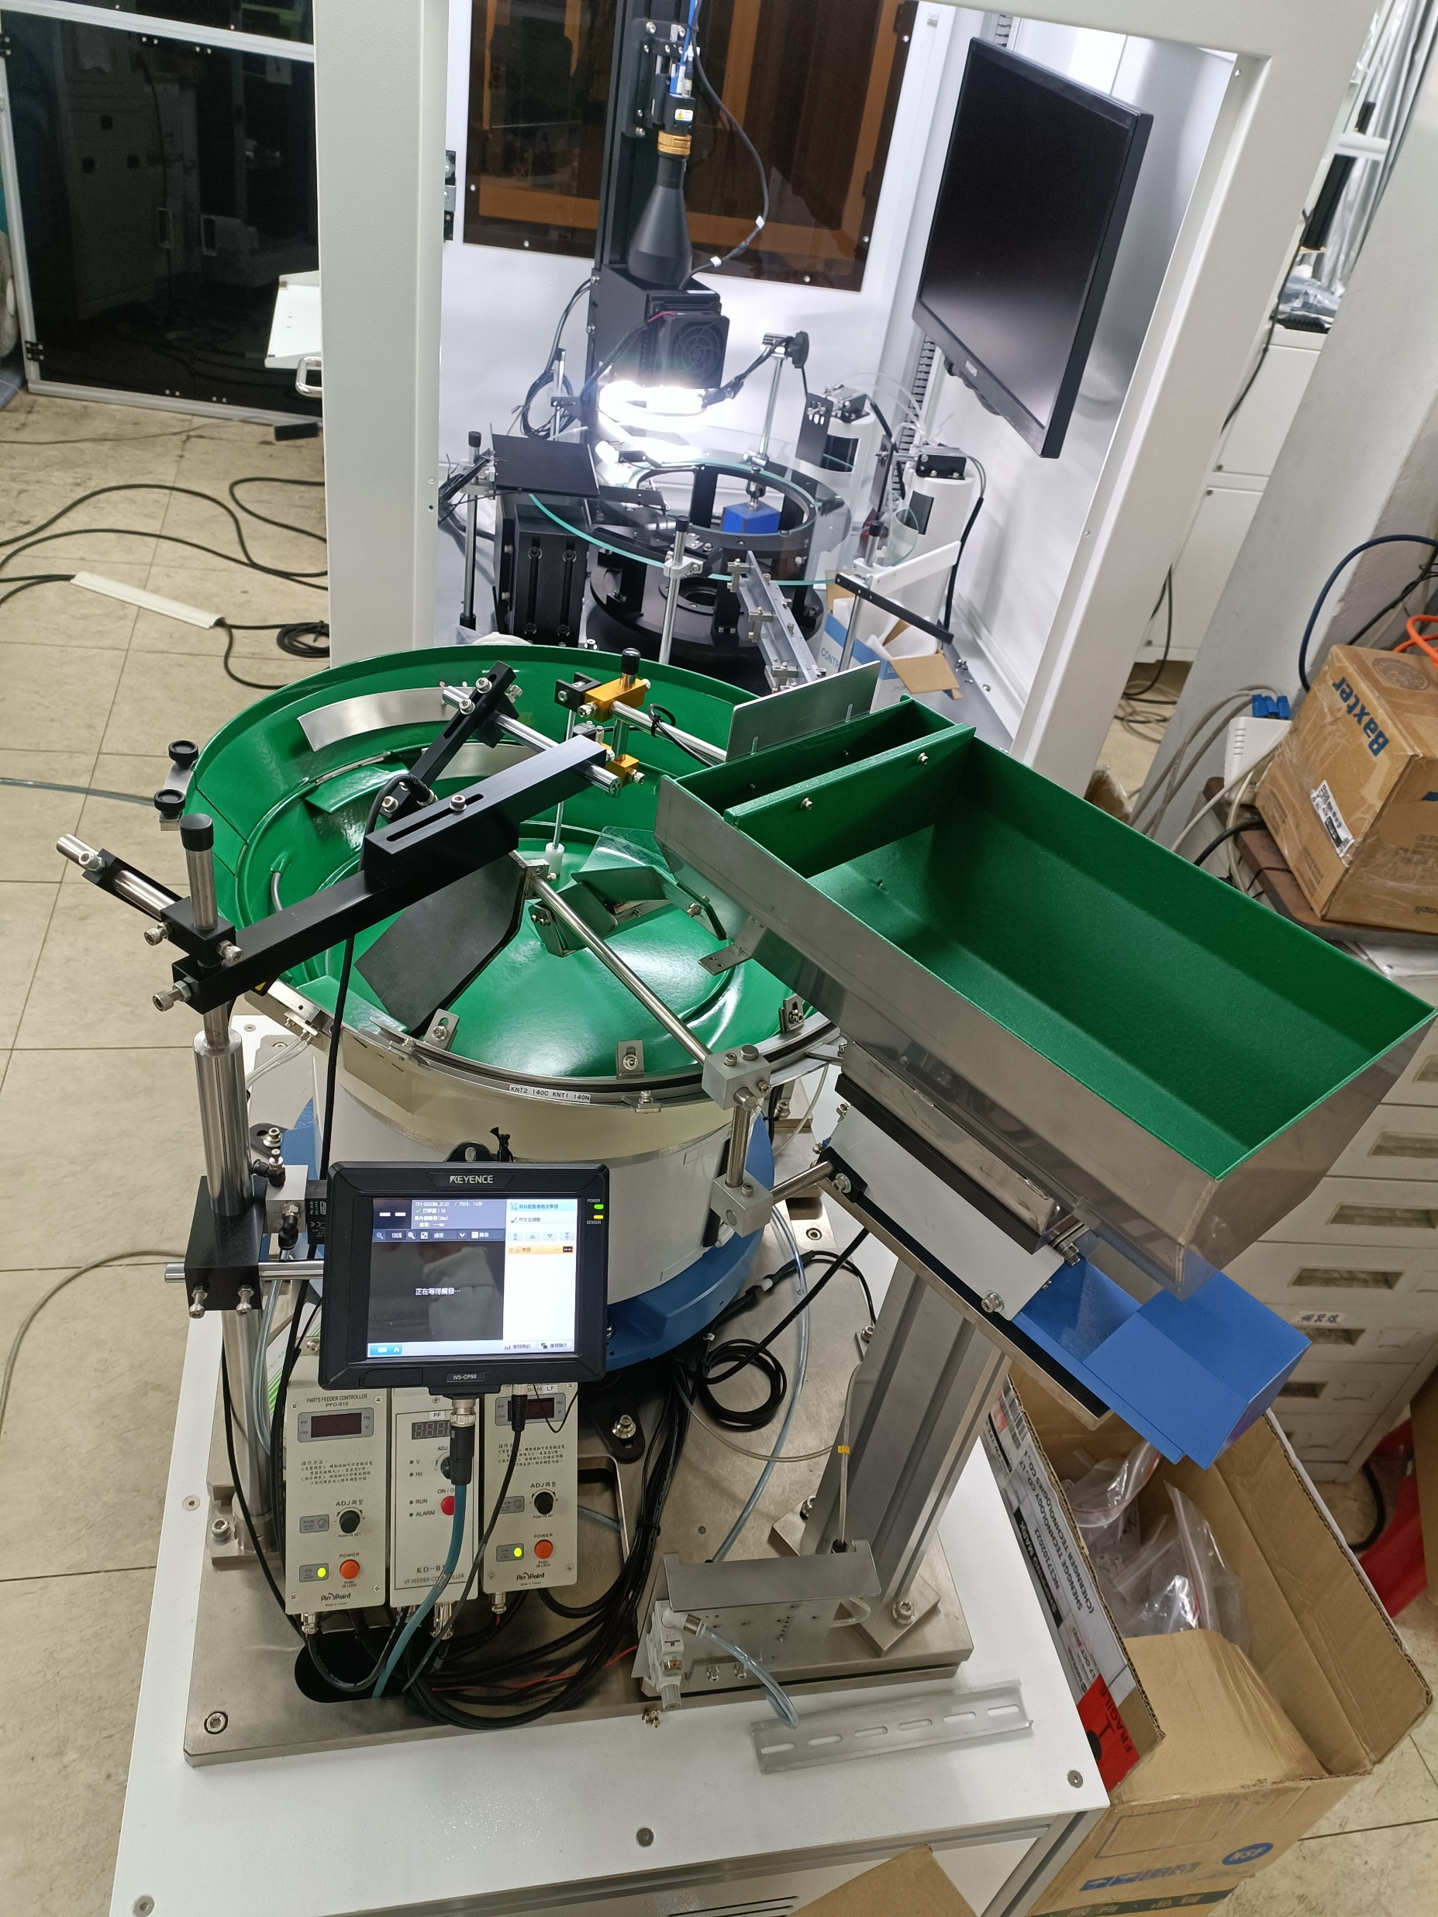
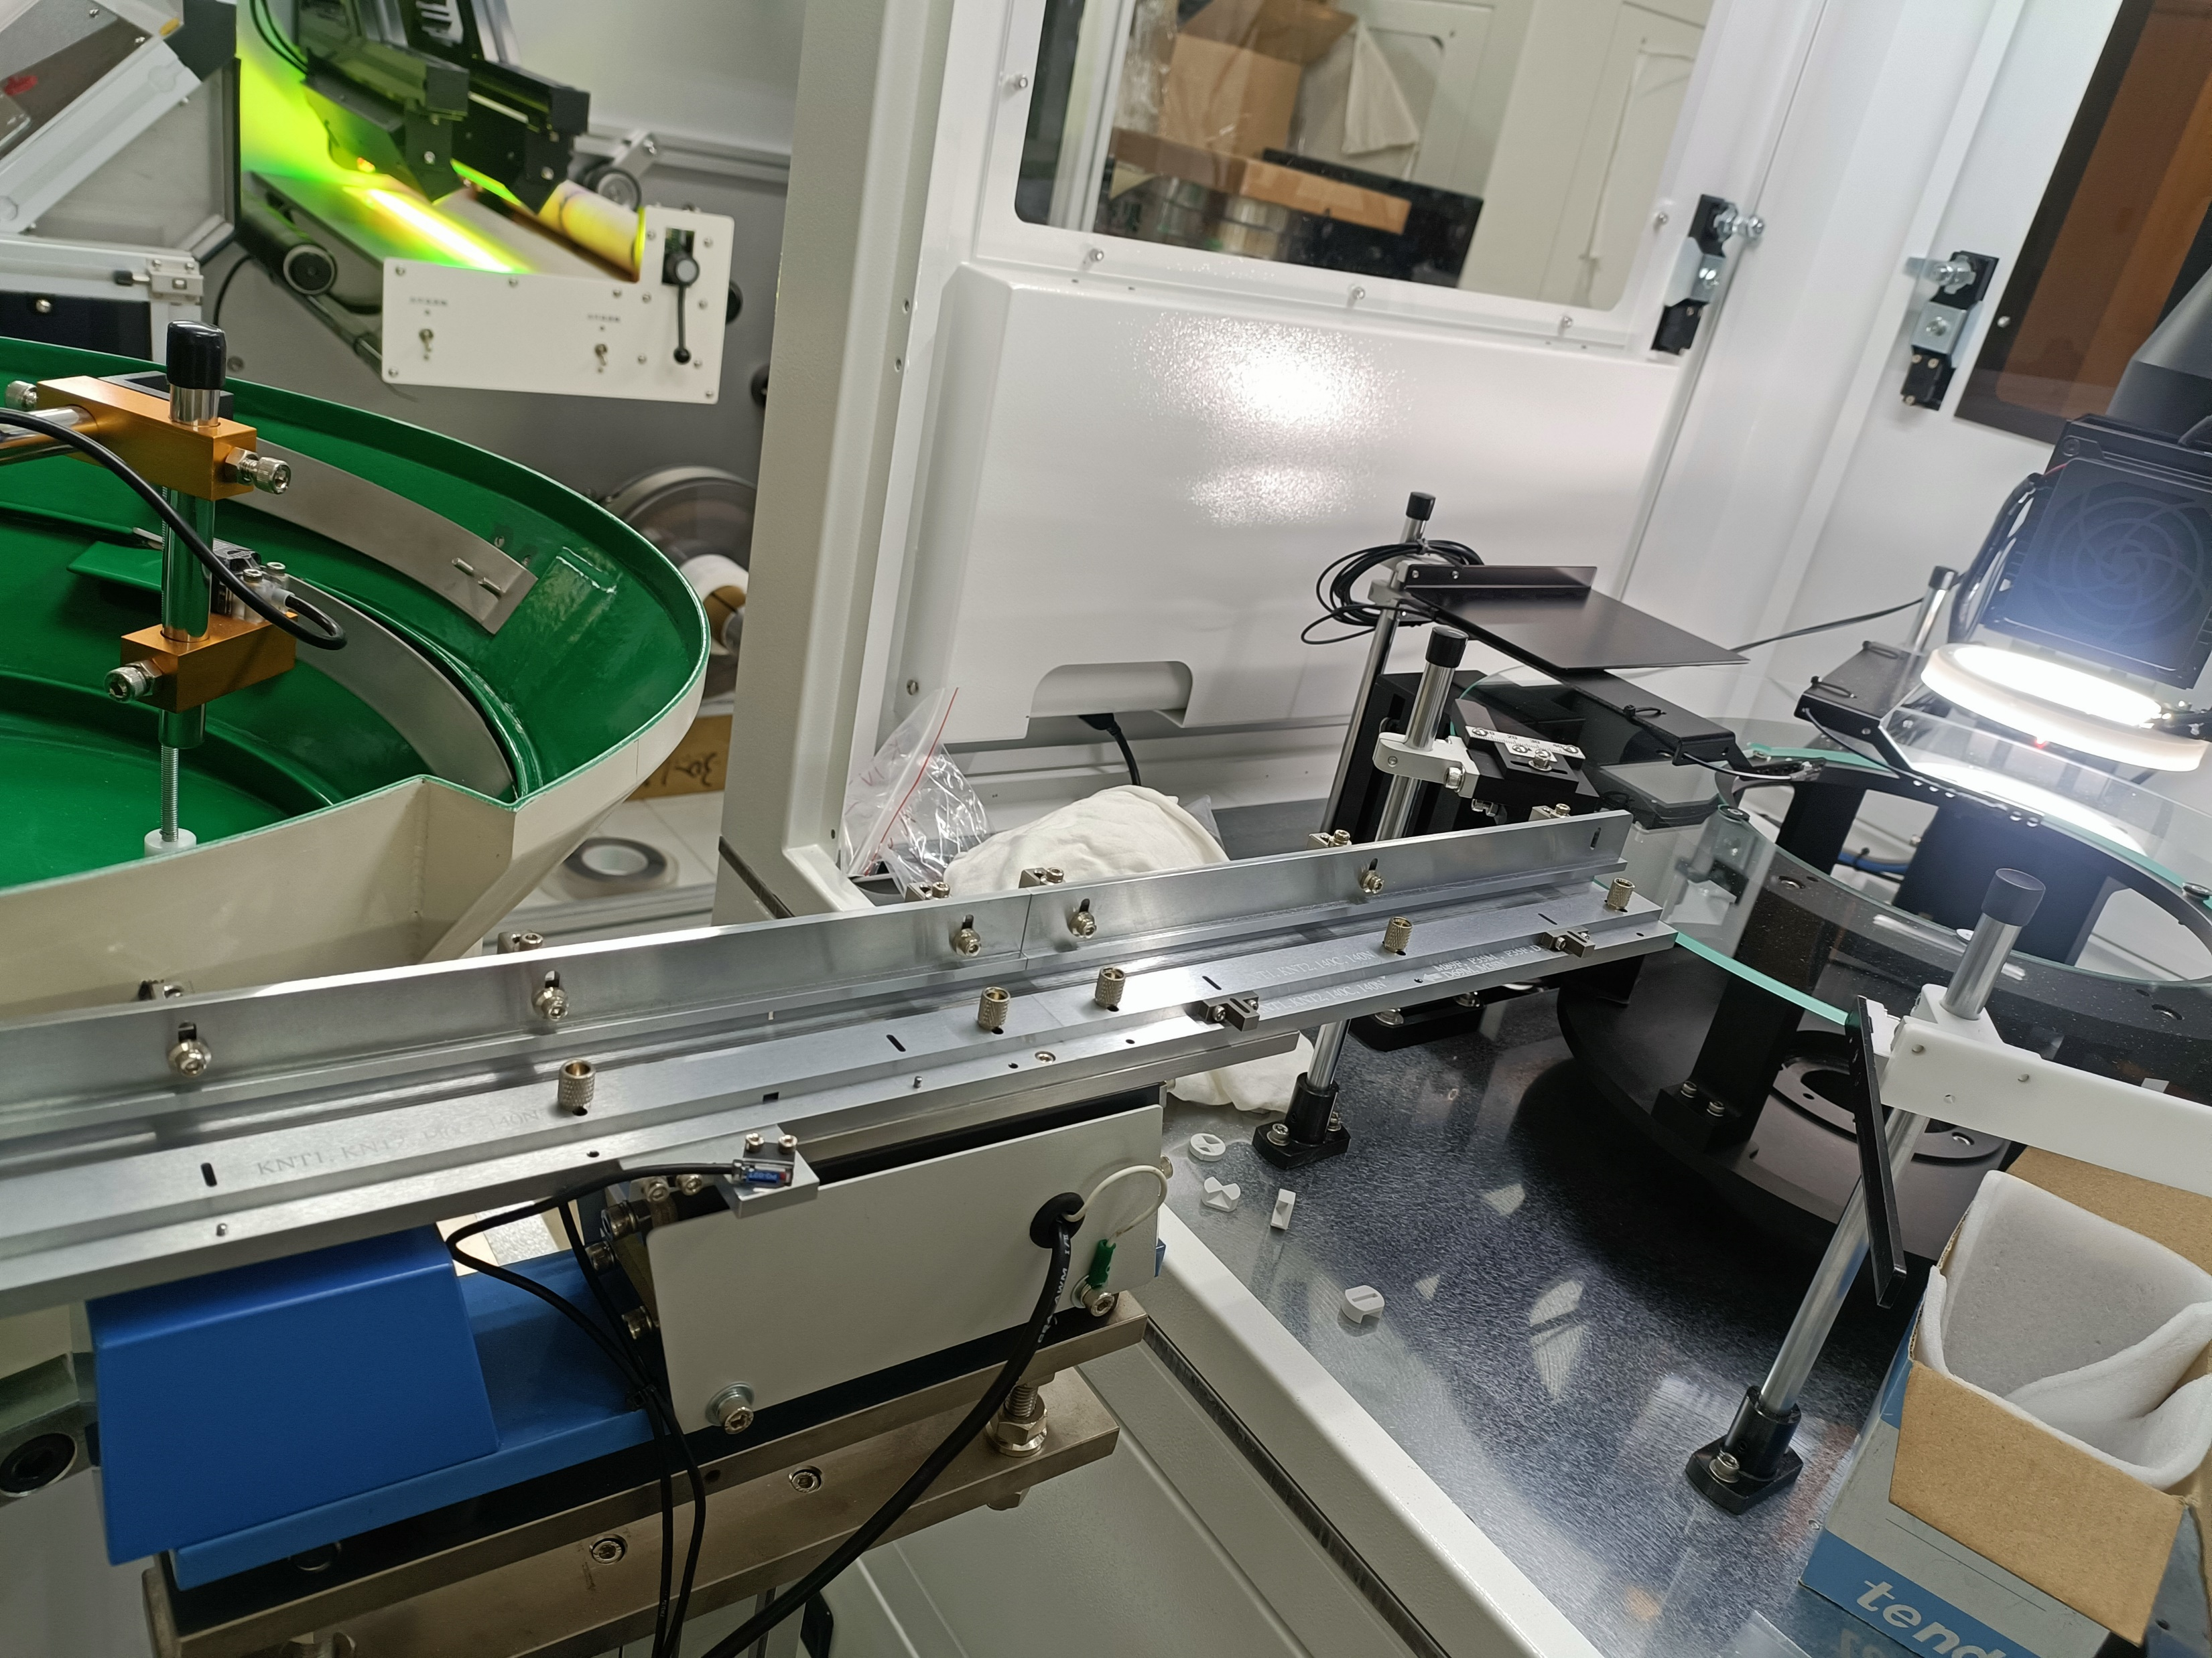
Environment

Slide 9
Environment
Second side for front part
OK
First side for back part
NG
NULL

Slide 10
Demonstration

Slide 11
Process: All Process
GUI: Graphical User Interface
AI: Artificial Intelligence
PLC: Programmable Logic Controller
Put Valve Core on Vibrating Plate
AI Decides if Reverse
First Side Decides if OK
Second Side Decides if OK
Push Them on Right Site
PLC Control
User Sets GUI
Notes:
GUI：圖形用戶界面（Graphical User Interface）
AI：人工智慧（Artificial Intelligence）
PLC：可編程邏輯控制器（Programmable Logic Controller）
將水閥芯放在震動板上
用戶設置GUI
AI決定是否放反
第一面決定是否OK
第二面決定是否OK
PCL控制
將水閥芯推到正確的位置

Slide 12
Process: All Process
GUI: Graphical User Interface
AI: Artificial Intelligence
PLC: Programmable Logic Controller
Put Valve Core on Vibrating Plate
AI Decides if Reverse
First Side Decides if OK
Second Side Decides if OK
Push Them on Right Site
PLC Control
User Sets GUI
Notes:
將水閥芯放在震動板上
用戶設置GUI
AI決定是否放反
第一面決定是否OK
第二面決定是否OK
PCL控制
將水閥芯推到正確的位置

Slide 13
Process: GUI

Slide 14
Process: All Process
GUI: Graphical User Interface
AI: Artificial Intelligence
PLC: Programmable Logic Controller
Put Valve Core on Vibrating Plate
AI Decides if Reverse
First Side Decides if OK
Second Side Decides if OK
Push Them on Right Site
PLC Control
User Sets GUI

Slide 15
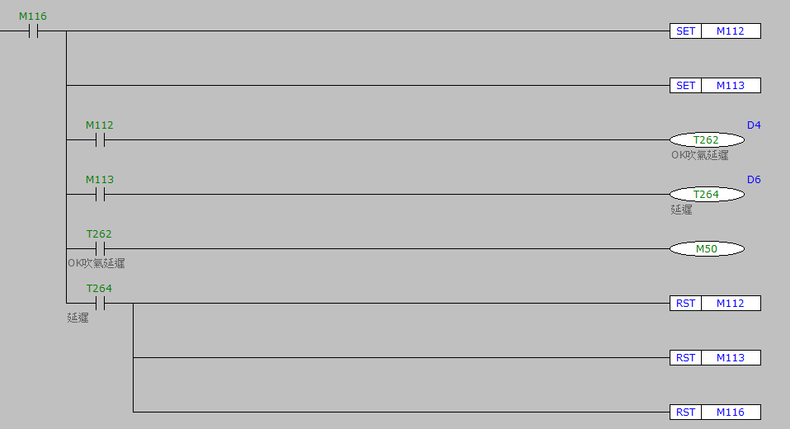
Process: PLC

Slide 16
Process: AI Part
YOLO: You Only Look Once
HSV: Hue, Saturation, Value
Preprocessed Image
Anomalib
HSV
Chipping
If YOLO Detect
Compute Size
YOLOv5
Spot
Compute Size
Crack
Compute Size

Slide 17
Process: AI Part
YOLO: You Only Look Once
HSV: Hue, Saturation, Value
Preprocessed Image
Anomalib
HSV
Chipping
If YOLO Detect
Compute Size
YOLOv5
Spot
Compute Size
Crack
Compute Size

Slide 18
Process: AI Part Anomalib
The library has a strong focus on image-based anomaly detection, where the goal of the algorithm is to identify anomalous images, or anomalous pixel regions within images in a dataset.
Notes:
該圖書館專注於基於圖像的異常檢測，算法的目標是在數據集中識別異常圖像或圖像內的異常像素區域。

Slide 19
Process: AI Part Anomalib
PaDiM: Patch Distribution Modeling Framework for Anomaly Detection and Localization.
Each patch position is described by a multivariate Gaussian distribution.
PaDiM takes into account the correlations between different semantic levels of a pretrained CNN.
We choose as pretrained networks a ResNet. PaDiM outperforms the current state-of-the-art methods. Moreover, its time complexity is low and independent of the training dataset size at the prediction stage.
Notes:
片段分布模型網路
每個片有多個高斯
計算相關性
時間複雜度低表現最好
PaDiM（Patch Distribution Modeling Framework for Anomaly Detection and Localization）：這是一個用於異常檢測和定位的補丁分布建模框架。每個補丁位置都由多變量高斯分布描述。PaDiM考慮了預訓練的CNN的不同語義層之間的相關性。我們選擇了ResNet作為預訓練網絡。PaDiM的性能優於當前的最新方法。而且，在預測階段，其時間複雜度低並且與訓練數據集的大小無關。

Slide 20
Process: AI Part Anomalib
Notes:
最後一項 full rank且可逆

Slide 21
Process: AI Part Anomalib
We use the Mahalanobis distance M(x_{ij}) to give an anomaly score to the patch in position (i, j) of a test image.
Patch embedding vectors are extracted from the first three layers when the backbone is a ResNet.

Slide 22
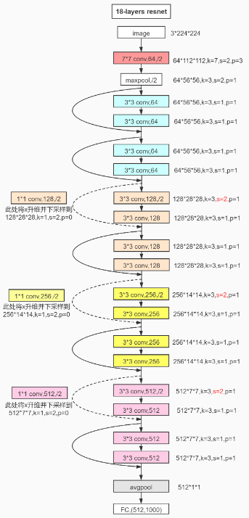
Process: AI Part Anomalib
Resnet: Residual neural network
Resnet framework

Slide 23
Process: AI Part Anomalib
AE: AutoEncoder
VAE: Variational AutoEncoder
SPADE: Semantic Pyramid Anomaly Detection
SVDD: Support Vector Data Description
AUROC: Area Under Receiver Operating Curve
PRO: Per Region Overlap
Notes:
影像重建後的誤差作為基準 特徵擷取

Slide 24
Process: AI Part Anomalib
We have presented a framework called PaDiM for anomaly detection and localization in one-class learning setting which is based on distribution modeling.
PaDiM low memory and time consumption and its ease of use make it suitable for our water valve.
Notes:
單次學習

Slide 25
Process: AI Part
YOLO: You Only Look Once
HSV: Hue, Saturation, Value
Preprocessed Image
Anomalib
HSV
Chipping
If YOLO Detect
Compute Size
YOLOv5
Spot
Compute Size
Crack
Compute Size

Slide 26
HSV
Hue: The basic property of color, for example red, yellow.
Saturation: Refers to the purity of the color, the higher the saturation, the purer the color.
Value: Brightness.
Since the output of Anomalib is a heat map, we thought HSV could find the warm color parts.

Slide 27
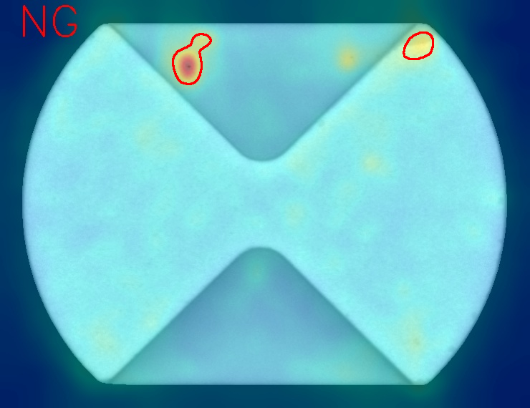
HSV
Before
After
Result

Slide 28
Process: AI Part
Preprocessed Image
Anomalib
HSV
Chipping
If YOLO Detect
Calculate size
YOLOv5
Spot
Calculate size
Crack
Calculate size

Slide 29
Process: AI Part
YOLO: You Only Look Once
HSV: Hue, Saturation, Value
Preprocessed Image
Anomalib
HSV
Chipping
If YOLO Detect
Compute Size
YOLOv5
Spot
Compute Size
Crack
Compute Size

Slide 30
Process: AI Part YOLO

Slide 31
Process: AI Part YOLO
Before
After

Slide 32
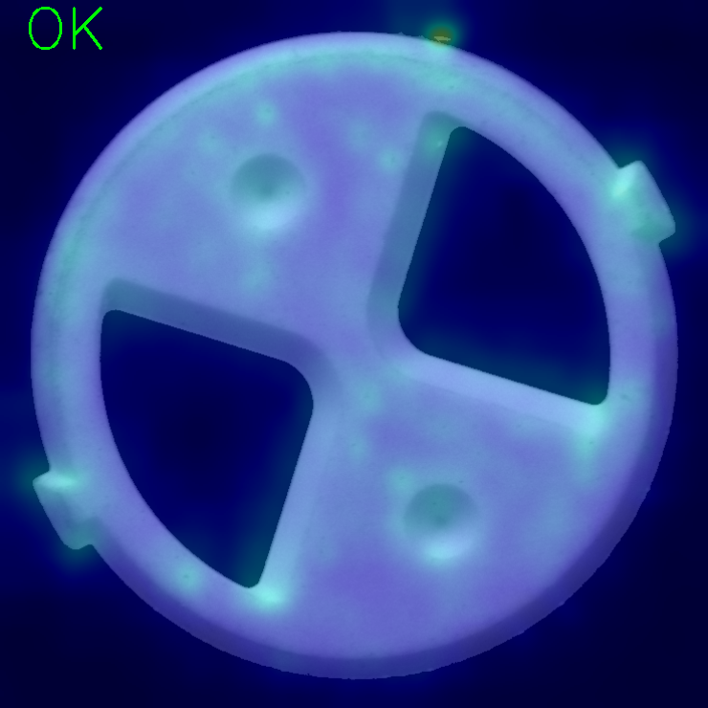
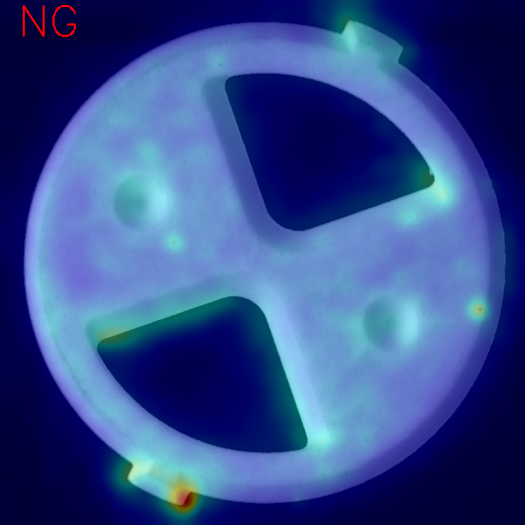
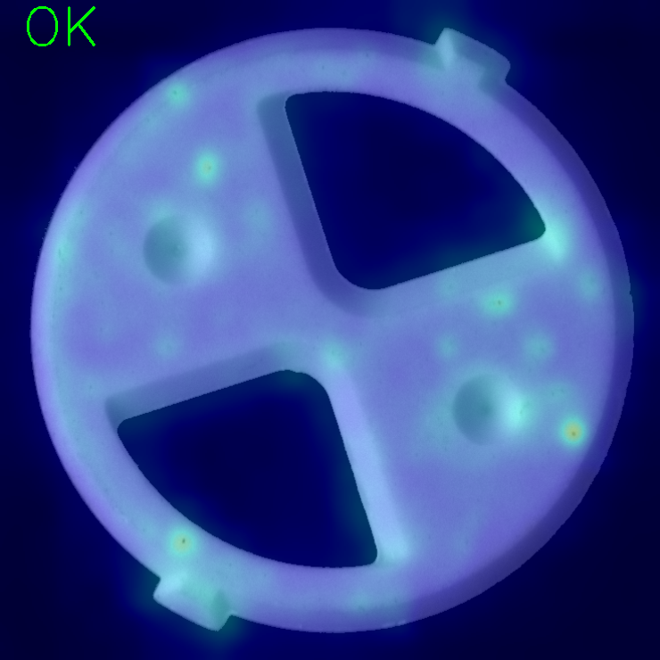
Problem and Solution (140N)

Slide 33
Spot will affect the result of Anomalib.
Hence, we decided to use YOLO to find the spot and cracks.
Also, we used Anomalib to find the chipping.
Notes:
斑點將影響 Anomalib 的結果。因此，我們決定使用 YOLO 來檢測斑點和裂痕。同時，我們使用 Anomalib 來尋找剝落。

Slide 34
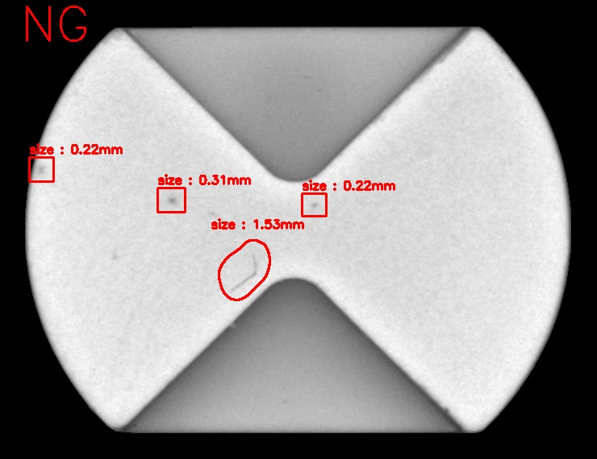
Anomalib Finds Chipping; YOLO Finds Spot
0.0204mm/ pixel

Slide 35
Inspect Speed
140N/ 0.3sec
140C/ 0.3sec
KNT1/ 0.3sec
KNT2/ 0.5sec
YNT2/ 0.5sec
D68F/ 0.4sec
D69M/ 0.4sec
M38N/ 0.4sec
M89F/ 0.6sec
P35F/ 0.4sec
P35M/ 0.4sec.

Slide 36
Results
Only Front | Good | OK | NG | Yield Rate | Spot | OK | NG | Yield Rate | Chipping | OK | NG | Yield Rate | Chipping_Crack | OK | NG | Yield Rate | Crack | OK | NG | Yield Rate | No_Lapping | OK | NG | Yield Rate
140N |  | 75 | 12 | 86.21% |  | 29 | 19 | 60.42%
140C |  | 38 | 6 | 86.36% |  | 31 | 18 | 63.27% |  | 2 | 12 | 14.29% |  |  |  |  |  |  |  |  |  | 2 | 11 | 15.38%
KNT1 |  | 38 | 12 | 74.51% |  | 12 | 38 | 23.53% |  |  |  |  |  |  |  |  |  |  |  |  |  | 0 | 15 | 0%
KNT2 |  | 75 | 10 | 88.24% |  | 37 | 18 | 66.07%
YNT2 |  | 74 | 8 | 90.24% |  | 45 | 6 | 86.54% |  | 4 | 11 | 26.27%
D68F |  | 78 | 20 | 79.59% |  | 3 | 11 | 21.43% |  | 7 | 7 | 50% |  | 2 | 12 | 14.29%
D69M |  | 52 | 44 | 53.61% |  | 3 | 11 | 21.43% |  | 4 | 11 | 26.67%
M38N |  | 71 | 22 | 76.34% |  | 6 | 8 | 42.86% |  | 4 | 11 | 26.67%
M89F |  | 69 | 27 | 71.13% |  | 1 | 14 | 6.67% |  | 2 | 12 | 14.29% |  |  |  |  |  | 0 | 15 | 0% |  | 0 | 14 | 0%
P35M |  | 25 | 10 | 71.43% |  | 2 | 49 | 3.85% |  | 3 | 12 | 20%
P35F |  | 85 | 14 | 85% |  |  |  |  |  | 7 | 8 | 47% |  |  |  |  |  | 1 | 47 | 2.08%
Two sides | Good | OK | NG | Yield Rate | Spot | OK | NG | Yield Rate | Chipping | OK | NG | Yield Rate | Chipping_Crack | OK | NG | Yield Rate | Crack | OK | NG | Yield Rate | No_Lapping | OK | NG | Yield Rate
140N |  | 71 | 17 | 80.68% |  | 25 | 24 | 51.02%
140C |  | 39 | 5 | 84.78% |  | 31 | 19 | 62% |  | 1 | 13 | 7.14% |  |  |  |  |  |  |  |  |  | 2 | 11 | 15.38%
KNT1 |  | 36 | 14 | 72% |  | 9 | 42 | 17.65% |  |  |  |  |  |  |  |  |  |  |  |  |  | 0 | 15 | 0%
KNT2 |  | 69 | 16 | 81.18% |  | 30 | 26 | 53.57%
YNT2 |  | 69 | 12 | 84.51% |  | 44 | 8 | 84.61% |  | 5 | 10 | 33.33%
D68F |  | 49 | 49 | 50% |  | 1 | 13 | 7.14% |  | 2 | 12 | 13.33% |  | 1 | 13 | 7.14%
D69M |  | 49 | 48 | 50% |  | 2 | 12 | 14.29% |  | 2 | 13 | 13.33%
M38N |  | 53 | 40 | 56.38% |  | 0 | 14 | 0% |  | 5 | 10 | 33.33%
M89F |  | 49 | 48 | 50% |  | 0 | 15 | 0% |  | 3 | 11 | 21.43% |  |  |  |  |  | 0 | 15 | 0% |  | 0 | 14 | 0%
P35M |  | 19 | 16 | 54% |  | 0 | 51 | 0% |  | 0 | 15 | 0%
P35F |  | 86 | 12 | 86.87% |  |  |  |  |  | 6 | 9 | 40% |  |  |  |  |  | 0 | 48 | 0%

Slide 37
Conclusion
Method: Anomalib and YOLOv5
Steps: Put Valve Core on Vibrating Plate => User Sets GUI => AI Decides if Reverse => First Side Decides if OK => Second Side Decides if OK => PLC Control => Push Them on Right Site
Results: We could inspect 11 types of water valve core defects through one machine.

Slide 38
References
Water valve pictures https://zhuanlan.zhihu.com/p/213960356
Gaussian Blur pictures https://blog.csdn.net/chentravelling/article/details/48985561
Erode Dilate pictures https://theailearner.com/category/image-processing/page/5/
Histogram normalization pictures https://blog.csdn.net/Vermont_/article/details/108360007
Convex hull pictures https://www.cnblogs.com/jclian91/p/9728488.html
Anomalib https://github.com/openvinotoolkit/anomalib https://arxiv.org/pdf/2202.08341v1.pdf
PaDiM https://arxiv.org/pdf/2011.08785.pdf
HSV https://zh.wikipedia.org/wiki/HSL%E5%92%8CHSV%E8%89%B2%E5%BD%A9%E7%A9%BA%E9%97%B4
Resnet https://arxiv.org/pdf/1512.03385v1.pdf https://blog.csdn.net/weixin_36979214/article/details/108879684?ops_request_misc=%257B%2522request%255Fid%2522%253A%2522162374909216780265420718%2522%252C%2522scm%2522%253A%252220140713.130102334..%2522%257D&request_id=162374909216780265420718&biz_id=0&utm_medium=distribute.pc_search_result.none-task-blog-2~all~sobaiduend~default-1-108879684.first_rank_v2_pc_rank_v29&utm_term=pytorch+resnet18&spm=1018.2226.3001.4187
YOLO https://arxiv.org/pdf/1506.02640.pdf https://github.com/ultralytics/yolov5

Slide 39
References
S. Akcay, D. Ameln, A. Vaidya, B. Lakshmanan, N. Ahuja, and U. Genc, “Anomalib: A Deep Learning Library for Anomaly Detection,” Proceedings of IEEE International Conference on Image Processing, Bordeaux, France, pp. 1706 - 1710, 2022.
Z. Chen, X. Huang, "End-to-End Learning for Lane Keeping of Self-Driving Cars," Proceedings of IEEE Intelligent Vehicles Symposium, vol. 4, pp. 1856-1860, 2017.
T. Defard, A. Setkov, A. Loesch, and R. Audigier, "PaDiM: a Patch Distribution Modeling Framework for Anomaly Detection and Localization," Proceedings of International Conference on Pattern Recognition, International Workshops and Challenges, Virtual, vol. 12664, pp. 475-489, 2021.
A. Dogra and A. Dogra, "Performance Comparison of Gaussian and Elliptic High Pass Filter," Proceedings of International Journal of Advanced Biological and Biomedical Research, vol. 3, no. 1, pp. 93-96, 2014.
D. Eberly, "Minimum-Area Rectangle Containing a Set of Points," https://www.geometrictools.com/Documentation/MinimumAreaRectangle.pdf, 2023.
K. Erickson, "Programmable Logic Controllers," Proceedings of IEEE Potentials, vol. 15, no. 1, pp. 14 - 17, 1996.
R. Girshick, J. Donahue, T. Darrell, and J. Malik, "Region-Based Convolutional Networks for Accurate Object Detection and Segmentation," Proceedings of IEEE Transactions on Pattern Analysis and Machine Intelligence, vol. 38, no. 1, pp. 142-158, 2016.
D. Gudovskiy, S. Ishizaka, and K. Kozuka, "CFLOW-AD: Real-Time Unsupervised Anomaly Detection with Localization via Conditional Normalizing Flows," Proceedings of IEEE/CVF Winter Conference on Applications of Computer Vision, Waikoloa, HI, pp. 1819 - 1828, 2022.
K. He, X. Zhang, S. Ren, and Jian Sun, "Deep Residual Learning for Image Recognition," Proceedings of IEEE Conference on Computer Vision and Pattern Recognition, Las Vegas, NV, pp. 770-778, 2016.
G. Jocher, "YOLOv5," https://github.com/ultralytics/yolov5, 2023.

Slide 40
References
Y. Lecun, L. Bottou, Y. Bengio, and P. Haffner, "Gradient-Based Learning Applied to Document Recognition," Proceedings of the IEEE, vol. 86, no. 11, pp. 2278 - 2324, 1998.
B. Leibe, A. Leonardis, and B. Schiele , "Robust Object Detection with Interleaved Categorization and Segmentation," Proceedings of International Journal of Computer Vision, vol. 77, no. 1, pp. 259-289, 2008.
Y. Q. Liu, X. Du, H. L. Shen, and S. J. Chen, "Estimating Generalized Gaussian Blur Kernels for Out-of-Focus Image Deblurring," Proceedings of IEEE Transactions on Circuits and Systems for Video Technology, vol. 31, no. 3, pp. 829-843, 2021.
L. G. Nyul, J. K. Udupa, and X. Zhang, "New Variants of a Method of MRI Scale Standardization," Proceedings of IEEE Transactions on Medical Imaging, vol. 19, no. 2, pp. 143-150, 2000.
J. Redmon, S. Divvala, R. Girshick, and A. Farhadi, "You Only Look Once: Unified, Real-Time Object Detection," Proceedings of IEEE Conference on Computer Vision and Pattern Recognition, Las Vegas, NV, pp. 779-788, 2016.
K. Roth, L. Pemula, J. Zepeda, B. Schölkopf, T. Brox, and P. Gehler, "Towards Total Recall in Industrial Anomaly Detection," Proceedings of IEEE/CVF Conference on Computer Vision and Pattern Recognition, New Orleans, LA, pp. 14298 - 14308, 2022.
O. Russakovsky, J. Deng, H. Su, J. Krause, S. Satheesh, S. Ma, Z. Huang, A. Karpathy, A. Khosla, M. Bernstein, A. C. Berg, and F. F. Li, "ImageNet Large Scale Visual Recognition Challenge," Proceedings of International Journal of Computer Vision, vol. 115, p. 211–252, 2015.
P. K. Sahoo, S. Soltani, and A. K. C. Wong, "A Survey of Thresholding Techniques," Proceedings of Computer Vision, Graphics, and Image Processing, vol. 41, no. 2, pp. 233-260, 1988.
K. A. M. Said and A. B. Jambek, "Analysis of Image Processing Using Morphological Erosion and Dilation," Proceedings of Journal of Physics: Conference Series, vol. 2071, no. 1, pp. 1-6, 2021.
M. Sharif, "A New Approach to Compute Convex Hull," Proceedings of Innovative Systems Design and Engineering, ISSN (Online) 2222-2871, vol. 2, no. 3, pp. 1-8, 2011.

Slide 41
References
D. Silver, A. Huang, C. J. Maddison, A. Guez, L. Sifre, G. V. D. Driessche. J. Schrittwieser, I. Antonoglou, V. Panneershelvam, M. Lanctot, S. Dieleman, D. Grewe, J. Nham, N. Kalchbrenner, I. Sutskever, T. Lillicrap, M. Leach, K. Kavukcuoglu, T. Graepel, and D. Hassabis, "Mastering the Game of Go with Deep Neural Networks and Tree Search," Proceedings of Nature, vol. 529, pp. 484-503, 2016.
A. R. Smith, "Color Gamut Transform Pairs," Proceedings of ACM SIGGRAPH Computer Graphics, vol. 12, no. 3, pp. 12-19, 1978.
A. M. Turing, "Computing Machinery and Intelligence," Proceedings of Mind, vol. 59, no. 236, pp. 433-460, 1950.
X. Yu, T. W. Kuan, Y. Zhang, and T. Yan, "YOLO v5 for SDSB Distant Tiny Object Detection," Proceedings of International Conference on Orange Technology, Shanghai, China, vol. 10, pp. 1-4, 2022.
K. P. Zhang, Z. P. Zhang, Z. F. Li, and Y. Qiao, "Joint Face Detection and Alignment Using Multitask Cascaded Convolutional Networks," Proceedings of IEEE Signal Processing Letters, vol. 23, no. 10, pp. 1499-1503, 2016.

